Slide 1


Tree Collections

Slide 2
Agenda
1. What are Tree Collections? (Overview)
2. The Red-Black Tree — Internal Data Structure
3. TreeSet — Overview & Key Characteristics
4. TreeSet — Working Code Example & Output
5. TreeMap — Overview & Key Characteristics
6. TreeMap — Working Code Example & Output
7. TreeSet vs TreeMap vs HashSet vs HashMap — Comparison Table

Slide 3
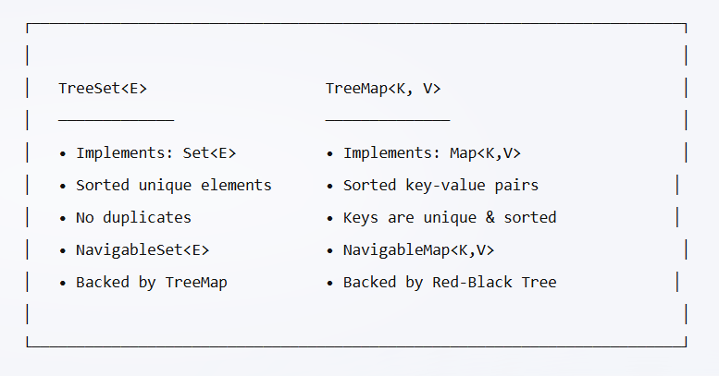
What are Tree Collections?
🌳 Tree Collections are sorted, navigable collections backed by a
Self-Balancing Binary Search Tree (Red-Black Tree).
📦Java provides TWO main Tree Collections:
🔑 Key Properties (Both):
✅ Elements/Keys are ALWAYS sorted
✅ O(log n) for add, remove, contains, get
✅ No null keys (TreeMap) / No null elements (TreeSet) — since Java 7
✅ NOT thread-safe (use Collections.synchronizedSortedSet/Map or ConcurrentSkipListMap)
✅ Fail-fast iterators

Slide 4
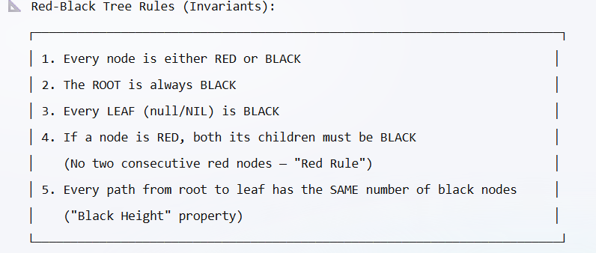
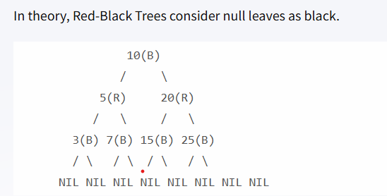
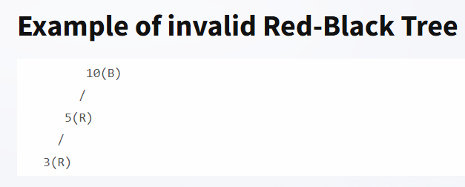
The Red-Black Tree — Internal Data Structure
📌 Red-Black Tree — The Engine Behind Tree Collections
🌳 What is a Red-Black Tree?
A self-balancing Binary Search Tree (BST) where each node has a COLOR (Red or Black) and the tree maintains balance through specific rules.

Slide 5
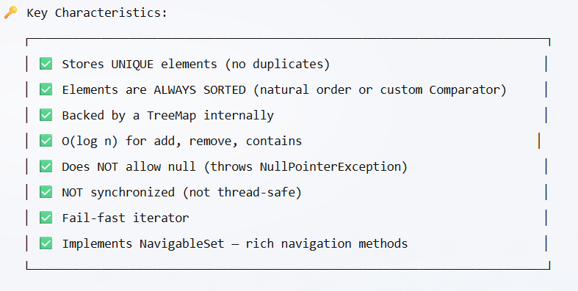
Tree Set
📦 Package: java.util
📐 Hierarchy: Set → SortedSet → NavigableSet → TreeSet
TreeSet() → Natural ordering
TreeSet(Comparator<? super E> comparator) → Custom ordering
TreeSet(Collection<? extends E> c) → From another collection
TreeSet(SortedSet<E> s) → From another SortedSet

Slide 6
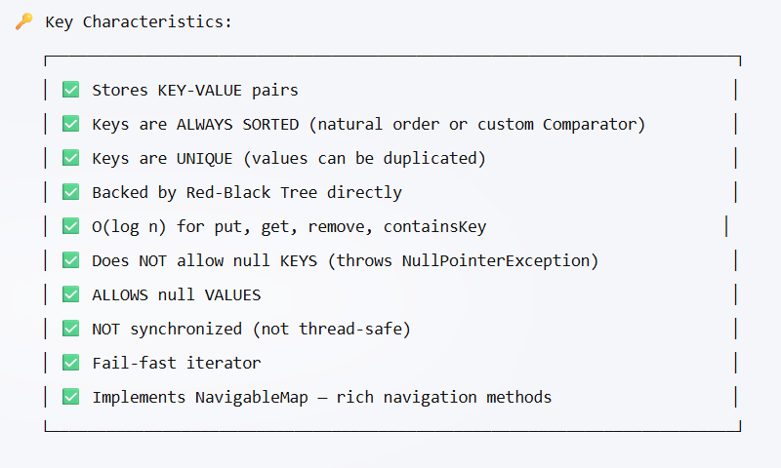
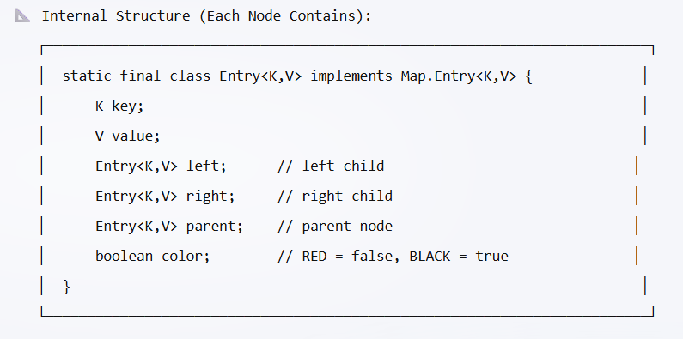
Tree Map
📦 Package: java.util
📐 Hierarchy: Map → SortedMap → NavigableMap → TreeMap
🏗️ Constructors:
┌───────────────────────┐
│ TreeMap() → Natural ordering of keys
│ TreeMap(Comparator<? super K> comparator)→ Custom ordering of keys
│ TreeMap(Map<? extends K, ? extends V> m) → From another Map
│ TreeMap(SortedMap<K, ? extends V> m) → From another SortedMap

Slide 7
🌳 TreeSet Use Cases:
┌─────────────────────┐
│ │
│ 1. 📊 Leaderboard / Rankings
│ → Maintain sorted scores, quickly find rank, top-N
│ │
│ 2. 📅 Event Scheduling
│ → Sorted events by time, find next/previous event
│ │
│ 3. 🎯 Auto-complete / Dictionary
│ → Sorted words, use subSet() for prefix matching
│ │
│ 4. 📈 Stock Price Tracking
│ → Maintain sorted prices, find floor/ceiling prices
│ │
│ 5. 🔢 Unique Sorted IDs
│ → Transaction IDs, order numbers in sorted order
│ │
│ 6. 🎮 Game — Maintaining sorted player scores
│ → Efficiently find player rank, nearby players
│ │

Slide 8
🌳 TreeMap Use Cases:
┌─────────────────────┐
│ │
│ 1. 📅 Calendar / Appointment System
│ → Keys = DateTime, Values = Event details
│ → Find next appointment: ceilingEntry(now)
│ │
│ 2. 💰 Price Range Queries (E-commerce)
│ → Keys = Price, Values = Products
│ → subMap(minPrice, maxPrice) for filtering
│ │
│ 3. 📖 Dictionary / Phone Book
│ → Alphabetically sorted entries with range lookups
│ │
│ 4. 🏦 Banking — Transaction History
│ → Keys = Date, Values = Transactions
│ → subMap(startDate, endDate) for statements
│ │
│ 5. 🎯 Rate Limiting / Sliding Window
│ → Keys = Timestamps of requests
│ → headMap(now - windowSize) to count recent requests
│ │
│ 6. 📊 Histogram / Frequency Distribution
│ → Keys = Buckets (sorted), Values = Counts

Slide 9
💡 When to Choose Tree Collections over Hash Collections:
┌─────────────────────┐
│ ✅ You need elements/keys in SORTED order
│ ✅ You need RANGE queries (subSet, subMap, headSet, tailSet)
│ ✅ You need NAVIGATION (floor, ceiling, lower, higher)
│ ✅ You need first/last element efficiently
│ ✅ You need a sorted iterator
│ ❌ DON'T use if you only need fast lookup without ordering
└───────────────────────┘

Slide 10
QUESTIONS ?

